Slide 1




PDS
slido.com
Computer Vision
https://github.com/siagianp
https://www.youtube.com/@AmelOline/videos
https://github.com/amelcharolinesgn2/Cloud-Infrastructures
https://github.com/amelcharolinesgn2/ClouD-Infrastructure-SISKA-2025
https://github.com/amelcharolinesgn2/CCNA1
https://github.com/amelcharolinesgn2/CCNA2
https://github.com/amelcharolinesgn2/AWS Certificate
Notes:
Lab Session 01: AWS Compute Foundations – EC2, Networking, and Application Deployment Lab Session 02: Identity and Access Control with IAM Lab Session 03: Cloud Storage Solutions – S3, EBS, and EFS Lab Session 04: Database Services – RDS, DynamoDB, and ElastiCache Lab Session 05: Load Balancing and Auto Scaling Lab Session 06: Container Orchestration with ECS, Fargate, and EKS Lab Session 07: Serverless Computing with Lambda Lab Session 08: Monitoring, Logging, and Security Auditing Lab Session 09: Infrastructure as Code – CloudFormation, CDK, and Terraform Lab Session 10: CI/CD Pipelines – App Runner, CodePipeline, GitHub Actions, and CodeDeploy Lab Session 11: AI/ML Services – Rekognition, Comprehend, Translate, and SageMaker Lab Session 12: Hybrid Cloud Networking – VPC Peering, Transit Gateway, VPN, and Direct Connect Lab Session 13: Security and Compliance – AWS Config, GuardDuty, Security Hub, and KMS Lab Session 14: Disaster Recovery and Business Continuity – AWS Backup, Multi-Region, and Failover Lab Session 15: Migration and Modernization – DataSync, DMS, MGN, Containers, and Serverless
Lab Session 16: Cost Management and Optimization – Cost Explorer, Trusted Advisor, Budgets, and Well-Architected
https://www.youtube.com/watch?v=SOTamWNgDKc&t=19604s

Slide 2



Do not edit
How to change the design
slido.com
Presenting with animations, GIFs or speaker notes? Enable our Chrome extension
Notes:
📣 This is Slido interaction slide, please don't delete it.
✅ Click on 'Present with Slido' and the joining instructions will appear when you get to this slide.

Slide 3

Do not edit
How to change the design
How can you prevent yourself from cloud over billing?
Presenting with animations, GIFs or speaker notes? Enable our Chrome extension
Notes:
📣 This is Slido interaction slide, please don't delete it.
✅ Click on 'Present with Slido' and the poll will launch automatically when you get to this slide.

Slide 4

Do not edit
How to change the design
What is your first OS?
Presenting with animations, GIFs or speaker notes? Enable our Chrome extension
Notes:
📣 This is Slido interaction slide, please don't delete it.
✅ Click on 'Present with Slido' and the poll will launch automatically when you get to this slide.

Slide 5
Cloud Operating Systems and Servers
The way to manage hardware and software resources in a cloud environment

Slide 6
Introduction to Cloud Operating Systems
Cloud Operating System (Cloud OS) manages hardware and software resources in a cloud environment.
It acts as a platform for cloud applications to run.
Enables scalability, virtualization, and multi-tenancy.
Examples: OpenStack, Windows Azure, Google Cloud OS.

Slide 7

Do not edit
How to change the design
Which of the following best defines a Cloud Operating System?
Presenting with animations, GIFs or speaker notes? Enable our Chrome extension
Notes:
📣 This is Slido interaction slide, please don't delete it.
✅ Click on 'Present with Slido' and the poll will launch automatically when you get to this slide.

Slide 8
Role of Cloud Operating System
Manages Virtual Machines (VMs): Provision, monitor, and destroy VMs.
Resource Management: Allocates CPU, memory, and storage dynamically.
User & Access Management: Multi-user, multi-tenant support.
Scalability & Elasticity: Supports automatic scaling.
Automation: Automated deployment, monitoring, and fault tolerance.

Slide 9
Do not edit
How to change the design
Which of the following is NOT a key function of a Cloud OS?
Presenting with animations, GIFs or speaker notes? Enable our Chrome extension
Notes:
📣 This is Slido interaction slide, please don't delete it.
✅ Click on 'Present with Slido' and the poll will launch automatically when you get to this slide.

Slide 10
Types of Cloud Operating Systems
Open Source Cloud OS: OpenStack, CloudStack.
Proprietary Cloud OS: Microsoft Azure, Google Cloud OS.
Hybrid Solutions: Combining private and public features.

Slide 11
Do not edit
How to change the design
Which of these is an open-source Cloud OS?
Presenting with animations, GIFs or speaker notes? Enable our Chrome extension
Notes:
📣 This is Slido interaction slide, please don't delete it.
✅ Click on 'Present with Slido' and the poll will launch automatically when you get to this slide.

Slide 12
Cloud Servers - Introduction
Cloud servers are virtual servers running in a cloud environment.
Hosted by cloud providers like AWS, Azure, GCP.
Highly scalable and can be deployed globally.
Types: Compute, Database, Storage, App Servers.

Slide 13
Do not edit
How to change the design
What is a key benefit of using cloud servers?
Presenting with animations, GIFs or speaker notes? Enable our Chrome extension
Notes:
📣 This is Slido interaction slide, please don't delete it.
✅ Click on 'Present with Slido' and the poll will launch automatically when you get to this slide.

Slide 14
Types of Cloud Servers
Compute Servers (EC2, VM Instances).
Database Servers (RDS, Cloud SQL).
Storage Servers (S3, Blob Storage).
Application Servers (App Engine, Elastic Beanstalk).

Slide 15
Do not edit
How to change the design
Which type of server is used primarily for computing in the cloud?
Presenting with animations, GIFs or speaker notes? Enable our Chrome extension
Notes:
📣 This is Slido interaction slide, please don't delete it.
✅ Click on 'Present with Slido' and the poll will launch automatically when you get to this slide.

Slide 16
Key Features of Cloud Operating System
Elastic Scaling: Automatically scales resources up/down.
API Access: Provides programmatic access to all services.
Resource Pooling: Combines resources for multi-tenancy.
Self-service Portals: Web interfaces for users to manage services.
Monitoring & Alerts: Tracks usage and health metrics.

Slide 17
Do not edit
How to change the design
Which feature allows developers to manage cloud resources using scripts or programs?
Presenting with animations, GIFs or speaker notes? Enable our Chrome extension
Notes:
📣 This is Slido interaction slide, please don't delete it.
✅ Click on 'Present with Slido' and the poll will launch automatically when you get to this slide.

Slide 18
Cloud Operating System vs Traditional Operating System
Feature Traditional OS Cloud OS
Hardware Local device Distributed cloud hardware
Users Single or few users Multi-tenant
Scalability Limited Elastic & dynamic Automation Minimal Highly automated
Deployment Manual Self-service & API-based

Slide 19
Do not edit
How to change the design
Which of the following is a major difference between traditional OS and Cloud OS?
Presenting with animations, GIFs or speaker notes? Enable our Chrome extension
Notes:
📣 This is Slido interaction slide, please don't delete it.
✅ Click on 'Present with Slido' and the poll will launch automatically when you get to this slide.

Slide 20
Security in Cloud Operating Systems
Data Encryption (at rest and in transit).
Identity & Access Management (IAM).
Firewall & Network Security Groups.
Monitoring & Intrusion Detection.
Compliance with standards (GDPR, HIPAA, SOC).

Slide 21
Do not edit
How to change the design
What is a critical security feature in Cloud OS?
Presenting with animations, GIFs or speaker notes? Enable our Chrome extension
Notes:
📣 This is Slido interaction slide, please don't delete it.
✅ Click on 'Present with Slido' and the poll will launch automatically when you get to this slide.

Slide 22
Future Trends in Cloud Operating Systems
AI-driven management (predictive scaling and self-healing).
Serverless integration (managing functions instead of VMs).
Hybrid cloud support (seamless on-prem and cloud operations).
Increased security automation.
More compliance-ready templates.

Slide 23
Do not edit
How to change the design
Which future trend will improve Cloud OS automation?
Presenting with animations, GIFs or speaker notes? Enable our Chrome extension
Notes:
📣 This is Slido interaction slide, please don't delete it.
✅ Click on 'Present with Slido' and the poll will launch automatically when you get to this slide.

Slide 24
What is Compliance in Cloud OS?
Compliance refers to adhering to laws, regulations, and standards to protect data, privacy, and system integrity in cloud environments.
Cloud Operating Systems (Cloud OS) must provide features and configurations to help organizations meet these requirements.

Slide 25
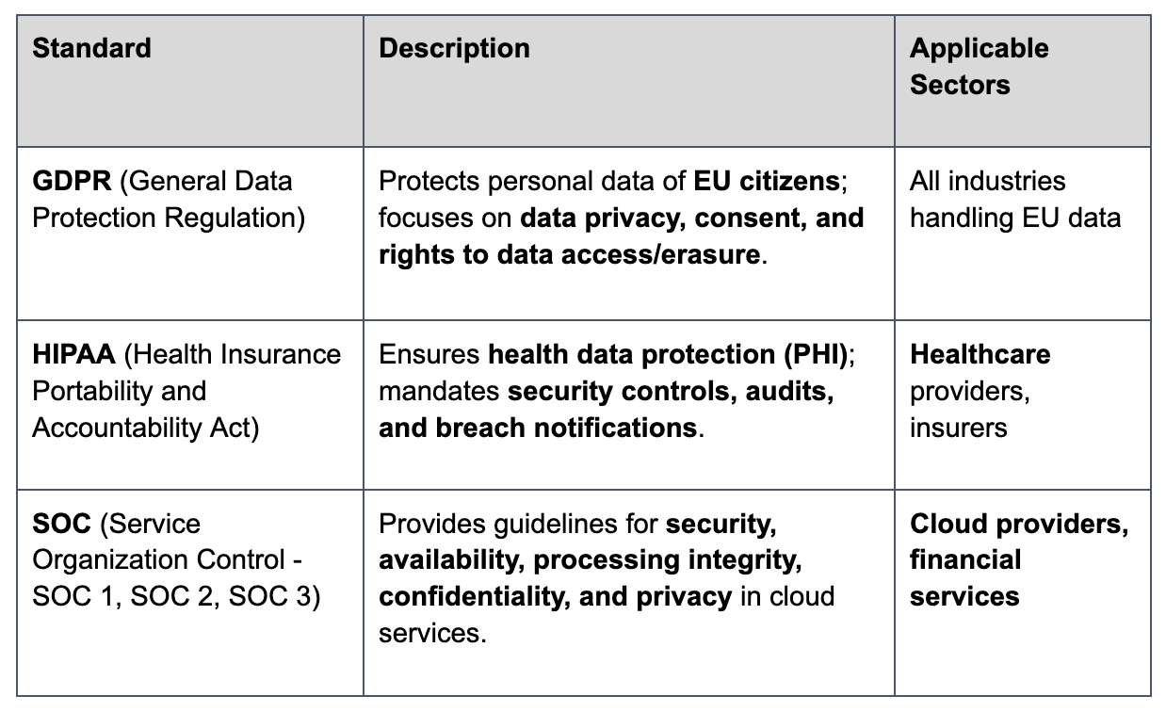
Key Standards Explained

Slide 26
Do not edit
How to change the design
Which of the following standards focuses specifically on protecting healthcare data?
Presenting with animations, GIFs or speaker notes? Enable our Chrome extension
Notes:
📣 This is Slido interaction slide, please don't delete it.
✅ Click on 'Present with Slido' and the poll will launch automatically when you get to this slide.

Slide 27
THANK YOU
Amel charoline
Amel Online & Irene magdalena
https://github.com/siagianp
https://www.youtube.com/@AmelOline/videos
https://github.com/amelcharolinesgn2/Cloud-Infrastructures
https://github.com/amelcharolinesgn2/ClouD-Infrastructure-SISKA-2025
https://github.com/amelcharolinesgn2/CCNA1
https://github.com/amelcharolinesgn2/CCNA2
https://github.com/amelcharolinesgn2/AWS Certificate

